Slide 1
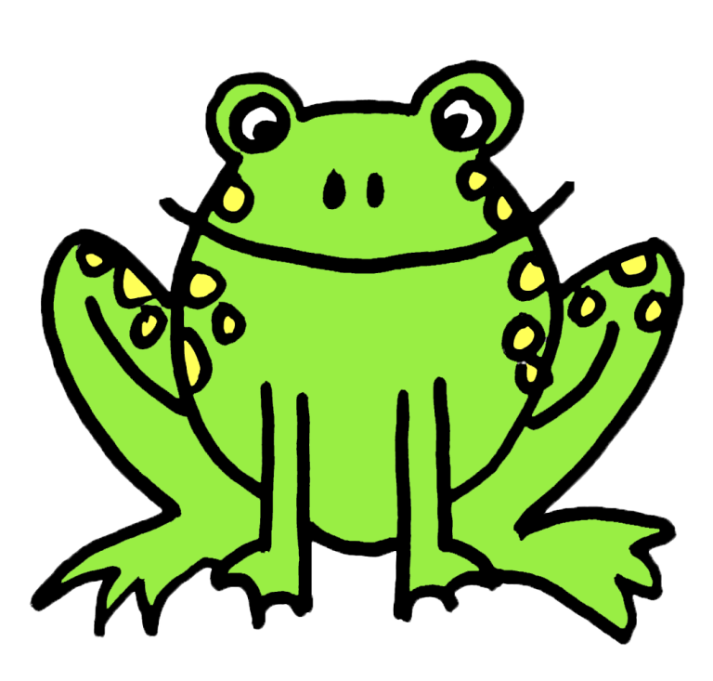
Frogs
Created by Katie Pipkin
http://kindergartensimplicity.blogspot.com

Slide 2
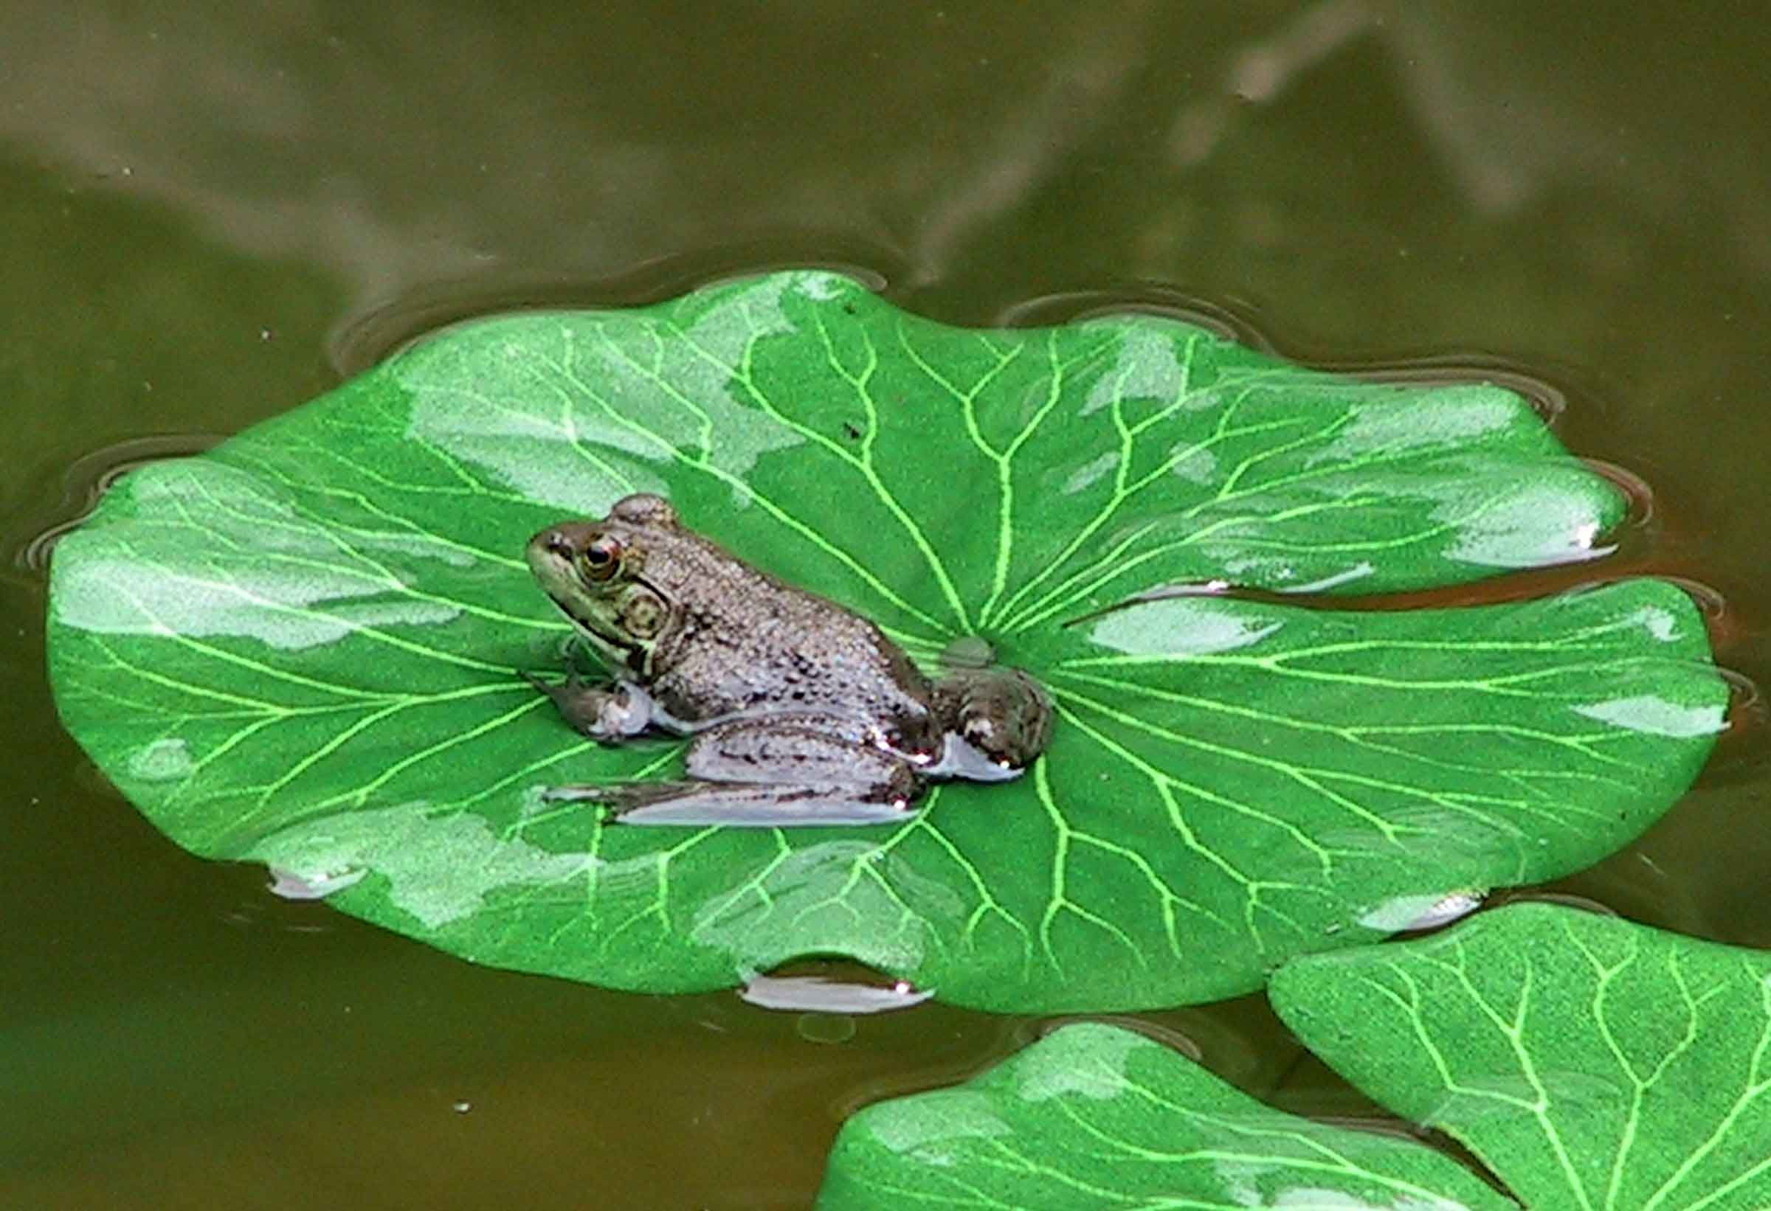
What are frogs?
Frogs are amphibians.
Amphibians are a group animals with soft, moist skin that live in both water and on land.
Frogs have strong back legs to help them jump.

Slide 3
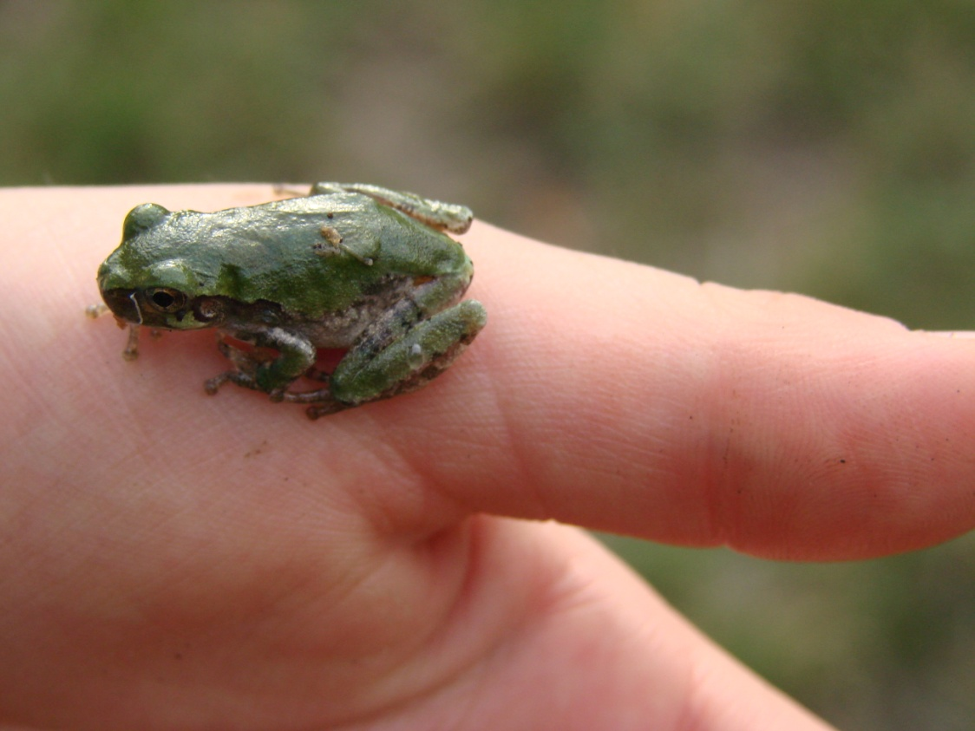
What do frogs look like?
Frogs are usually green or brown but can sometimes be very colorful.
Some have spots or stripes.
Frogs can be very small or as big as a bowling ball (bull frogs).

Slide 4
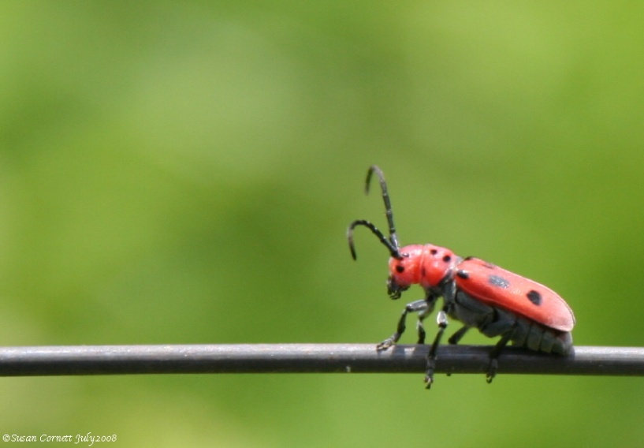
What do frogs eat?
Adult frogs are carnivores, which means they eat other animals.
Most frogs eat insects and worms.
Many frogs catch their food with their sticky tongues.

Slide 5
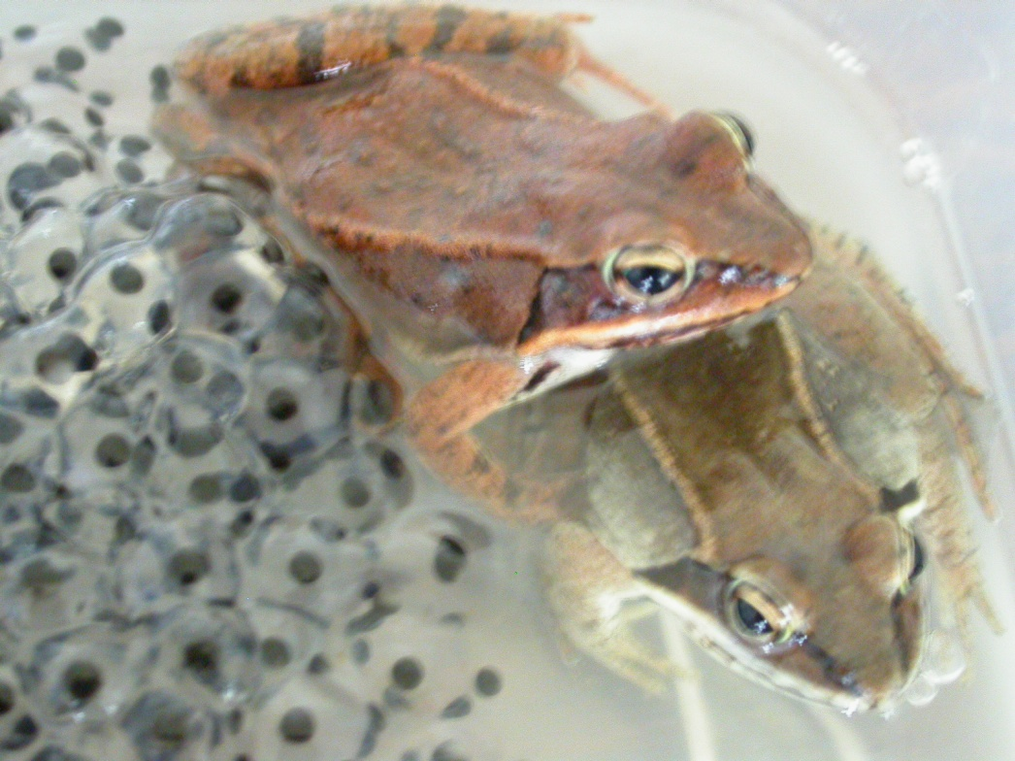
Frog Life Cycle - Egg
Frogs start their lives as an egg.
Frogs lay eggs in blobs of jelly.
This jelly protects the eggs as they grow.

Slide 6
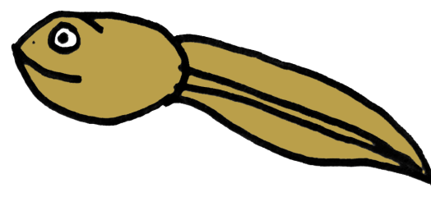
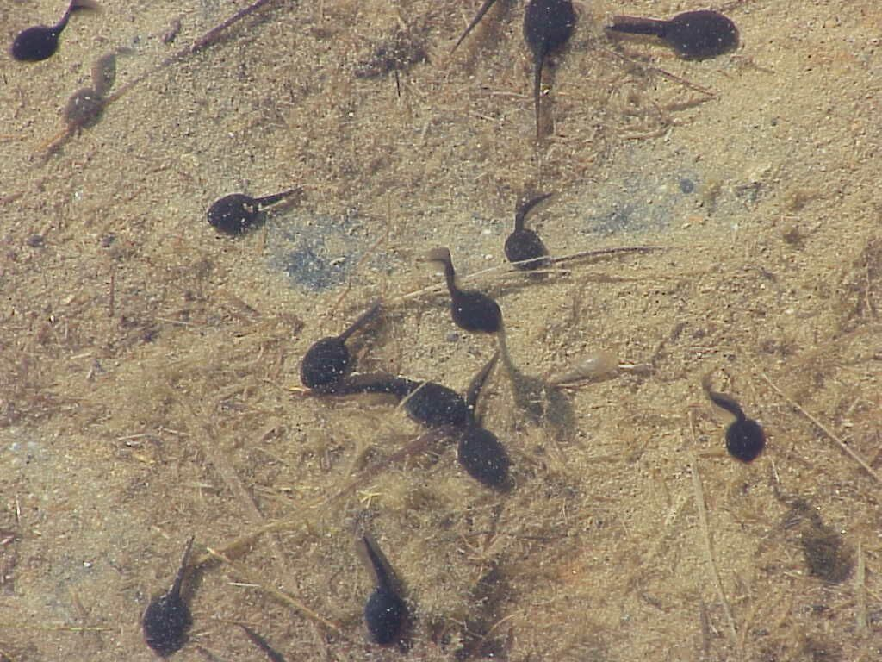
Frog Life Cycle - Tadpole
Tadpoles hatch from the egg.
Tadpoles live in water.
They have a tail and breath through gills.
Tadpoles eat algae (small underwater plants).

Slide 7
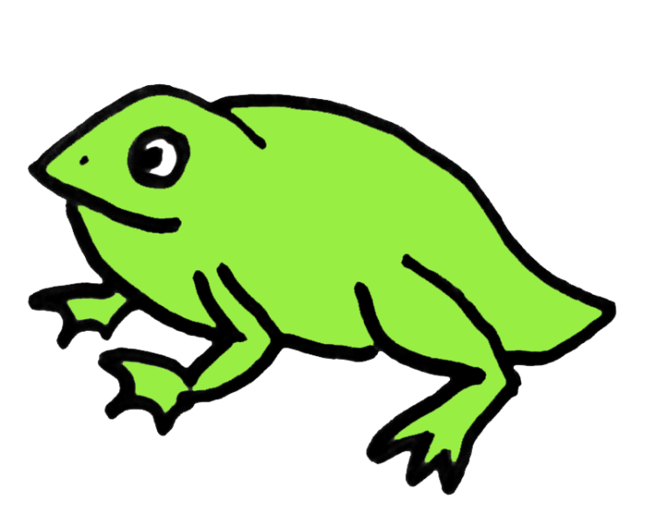
Frog Life Cycle - Froglet
After awhile, the tadpole begins to grow legs. Its tail gets smaller.
The tadpoles lungs develop so it can breathe air.
At this stage, the tadpole is called a froglet.

Slide 8
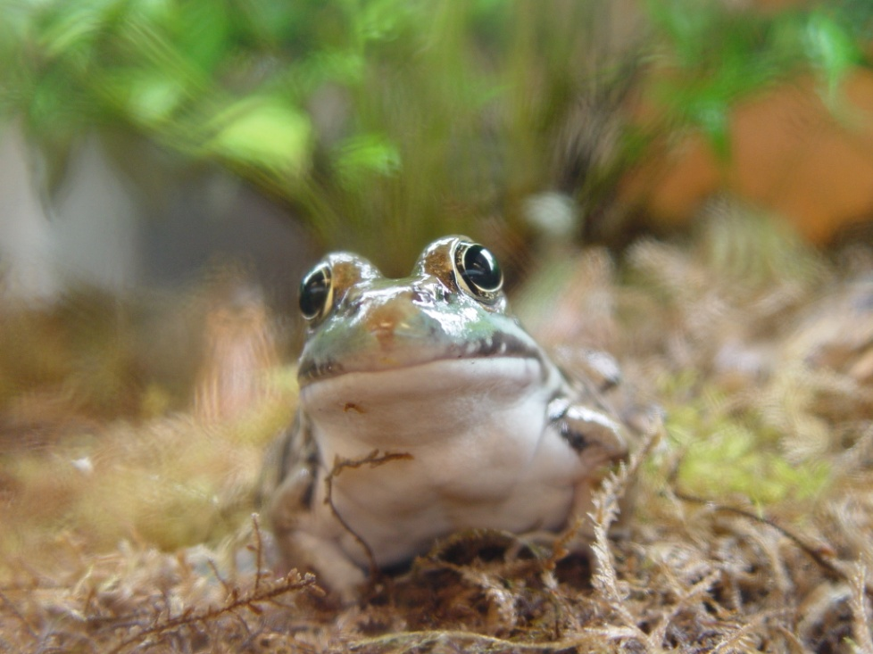
Frog Life Cycle – Adult Frog
Soon the froglet’s tail disappears and he crawls to land.
He is now an adult frog!
Female frogs can now lay eggs and start the cycle again!

Slide 9
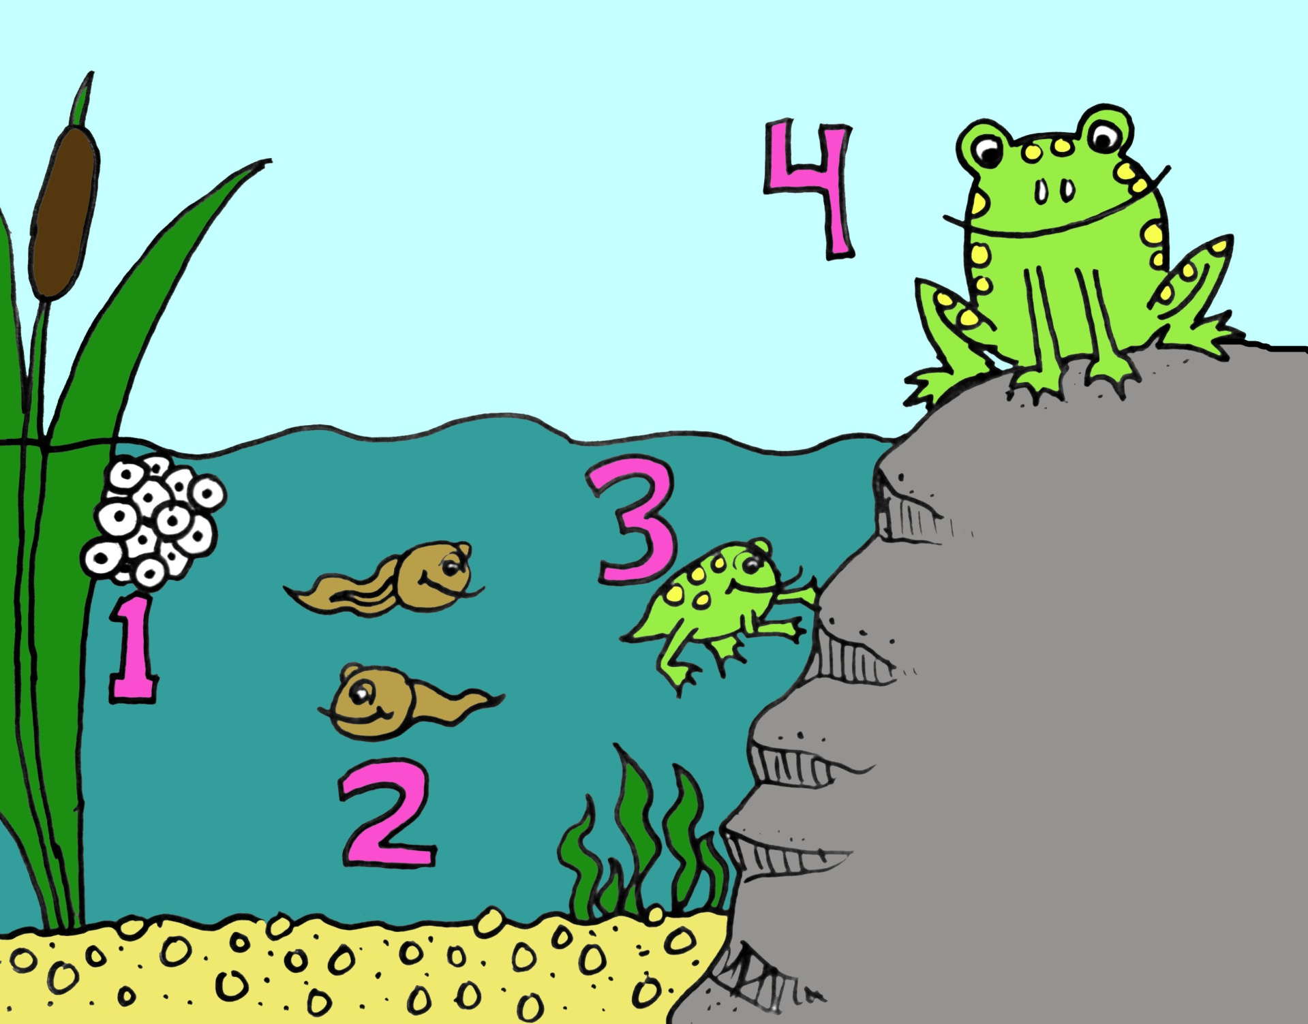

Slide 10
Credits
Slide backgrounds provided for free by http://www.dreamlikemagicblog.com/.
Clip art made by Katie Pipkin. Please do not remove from slides. http://kindergartensimplicity.blospot.com.
Free photographs are from http://www.pics4learning.com/ .

